Slide 1
Programmable Logic
PAL, PLA

Slide 2
PLAs
Programmable Logic Array
Pre-fabricated building block of many AND/OR gates (or NOR, NAND)
General purpose logic building blocks
“Personalized” or “customized” by making/ breaking connections among the gates
This process is called “programming”

Slide 3
PLA
Realizes Sums of Products

Slide 4
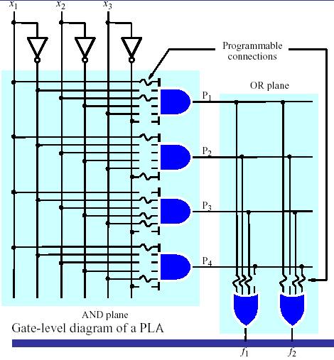
PLA

Slide 5
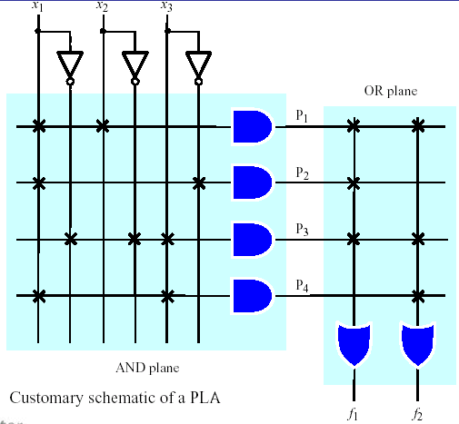
PLA
A 3×2 PLA with 4 product terms.

Slide 6
Design for PLA: Example
Implement the following functions using PLA
F0 = A + B' C'
F1 = A C' + A B
F2 = B' C' + A B
F3 = B' C + A
Input Side:
1 = asserted in term
0 = negated in term
- = does not participate
Personality Matrix
Product
Inputs
Outputs
t
Output Side:
erm
A
B
C
F
F
F
F
0
1
2
3
1 = term connected to output
0 = no connection to output
A B
1
1
-
0
1
1
0
B C
-
0
1
0
0
0
1
A C
1
-
0
0
1
0
0
B C
-
0
0
1
0
1
0
A
1
-
-
1
0
0
1

Slide 7
Example: Continued
A
B
C
F0 = A + B' C'
F1 = A C' + A B
F2 = B' C' + A B
F3 = B' C + A
AB
B’C
AC’
B’C’
A
F0
F1
F2
F3

Slide 8
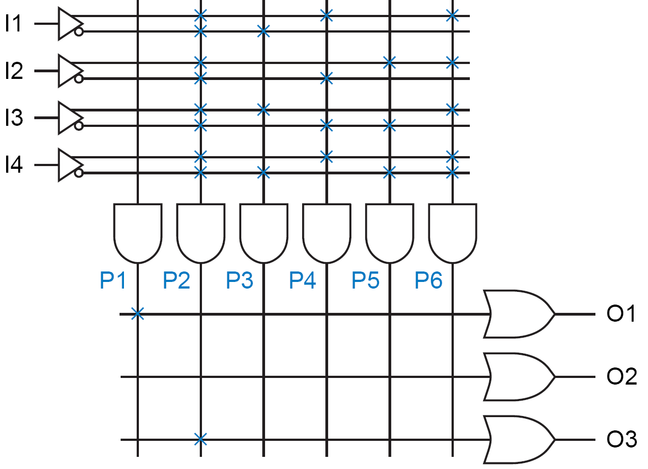

Constants
Sometimes a PLA output must be programmed to be a constant 1 or a constant 0.
Manufacturer MAY “pull up” the AND inputs:
P1 is always 1 because its product line is connected to no inputs and is therefore always pulled UP or HIGH.
This constant 1 term drives the O1 output.
Manufacturer MAY “pull down” the OR inputs:
No product term drives the O2 output, which is therefore always 0.
Another method of obtaining a constant-0 output is shown for O3.

Slide 9
Gray Codes
Gray codes are minimum change codes
From one numeric representation to the next, only one bit changes

Slide 10
Gray Codes (cont.)
Binary
0000
0001
0010
0011
0100
0101
0110
0111
1000
1001
1010
1011
1100
1101
1110
1111
Gray
0000
0001
0011
0010
0110
0111
0101
0100
1100
1101
1111
1110
1010
1011
1001
1000
Binary
00
01
10
11
Gray
00
01
11
10
Binary
000
001
010
011
100
101
110
111
Gray
000
001
011
010
110
111
101
100

Slide 11
BCD to Gray Code Converter
Minimized Functions:
W = A + B D + B C
X = B C'
Y = B + C
Z = A'B'C'D + B C D + A D' + B' C D'

Slide 12
Example (Continued)
Notes:
4 product terms pre-assigned to each OR gates’ inputs
The OR gates’ inputs are internally pulled down by the manufacturer
A B C D
A
BD
BC
BC’
B
C
BCD
AD’
BCD’
W X Y Z

Slide 13
PALs
Programmable Array Logic
Realizes Sums of Products but with a fixed OR array

Slide 14
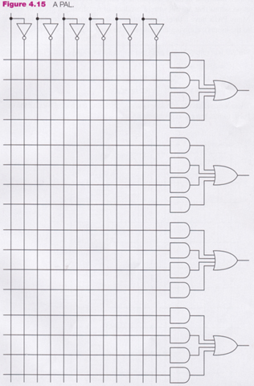
PAL
inputs
1st output
section
2nd output
section
Only functions with
at most four
products can be
implemented
3rd output
section
4th output
section

Slide 15
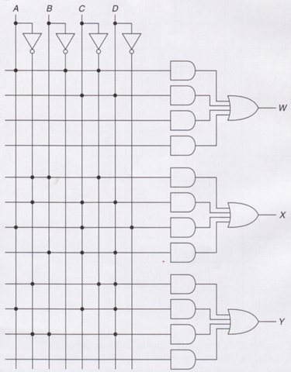
PAL
x
x
x
W = AB ′C ′ + CD
X = A ′BC ′ + A ′CD + ACD ′ + BCD
Y = A ′C ′D + ACD + A ′BD

Slide 16
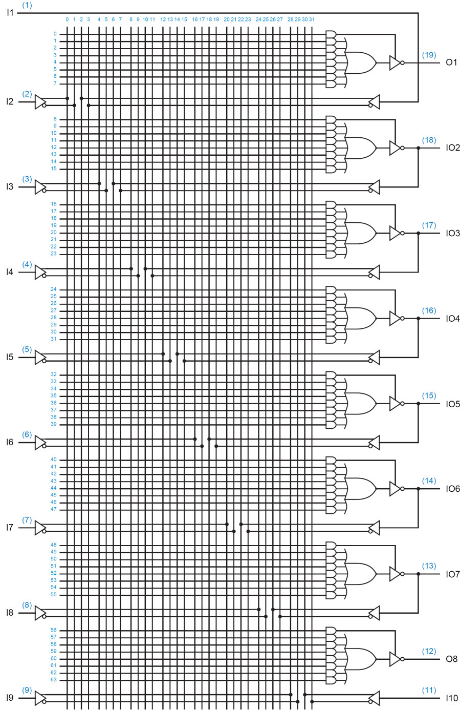
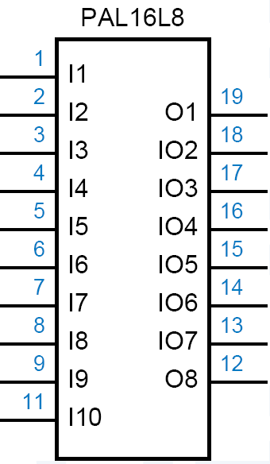

Slide 17

Helper Terms
If an I/O pin’s output-control gate produces a constant 1, → the output is always enabled,
The pin may be used as an input too.
Outputs can be used to generate first-pass “helper terms” for logic functions that cannot be performed in a single pass with the limited number of AND terms available for a single output.

